Slide 1
Business Operations
Enterprise Data & Analytics
March 2023

Slide 2
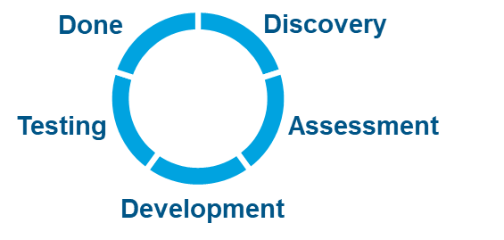








ED&A
Overall Projects Roadmap
Legend
ED&A Projects LTD
Not Started
Ongoing
Completed
Projects | 2022 |  | 2023
 | Nov | Dec | Jan | Feb | March | April | May
USBU POD Reporting
POD Report Automation
CSIH
PSA/ Smartsheet integration
MedSci Opportunity Tracker
Main Dashboard
Quality Check /Analytics
Indiv. Report
GSE Monthly Account Dashboard
Sample Dashboard
Integrated Dashboard + QC Report
Testing
USCAN
Manual Slides Dashboard
Slides recreation
P1 metrics
Priority 2
Priority 3
ITS Data Warehouse
Data Lake – Raw Data
Data Warehouse – Curated Data
Dashboard creation
Atlas Internal Project
Timelines TBC
LAUNCH
Today

Slide 3
ED&A
Analytics
2023

Slide 4
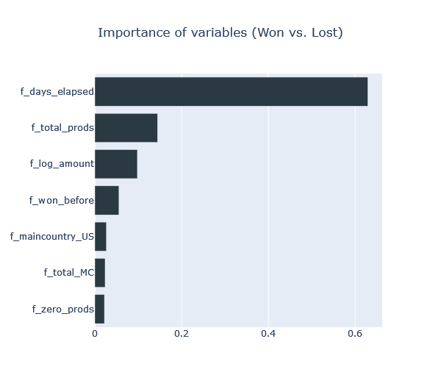
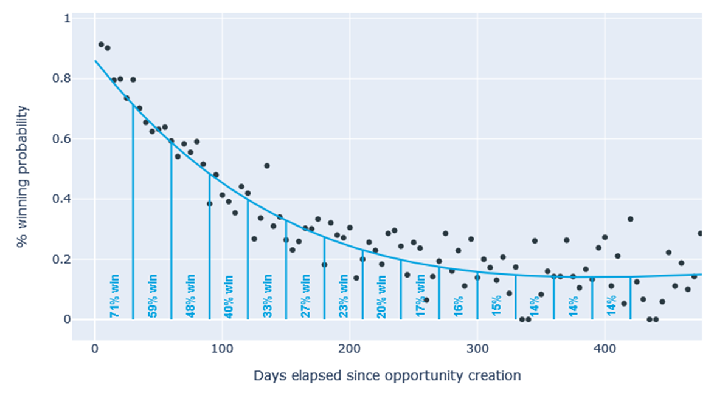
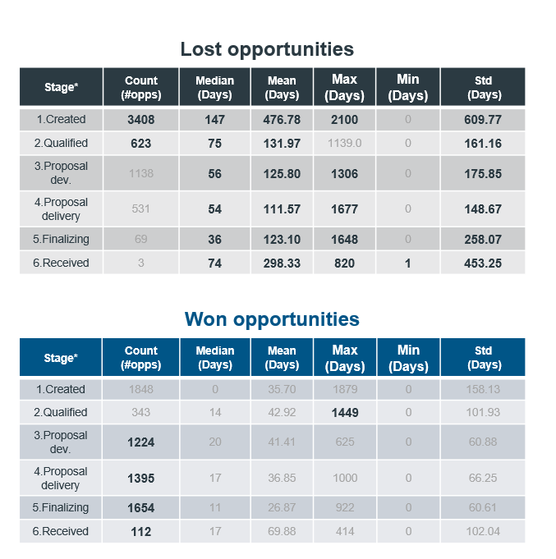
ED&A
Analytics
In the sales process, some variables have a greater impact on the likelihood of winning an opportunity than others. By identifying these key variables, efforts can be shifted to optimizing them, leading to a higher rate of success in winning opportunities.
Variable importance
In the first 30 days, the probability drops approximately 1% every 2 days.
Number of days elapse since creation
Total number of products
Opp. Amount
Opportunities Won before for account
Main Country
Total MC products
Total number of zero value products
What impacts the likelihood of winning an opportunity?
 | Number of days elapse since creation | Opp. Amount | Opportunities Won before for account | Total number of products | Total number of zero valued products | Main Country | Number of opportunities | % Won | %Lost
1 | <=30 | in [1500, 70150] | in [3, 84] |  |  |  | 517 | 91.49 | 8.51
2 | in [83, 343] | >=51000 |  | >=2 | >=1 |  | 116 | 88.79 | 11.21
3 | in [9, 30] | >=91000 |  | >=2 |  |  | 72 | 88.89 | 11.11

Slide 5
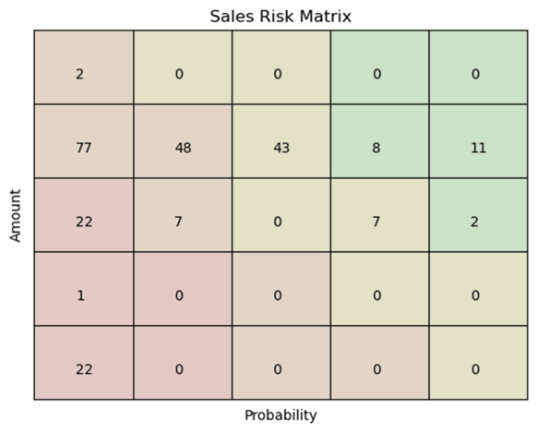
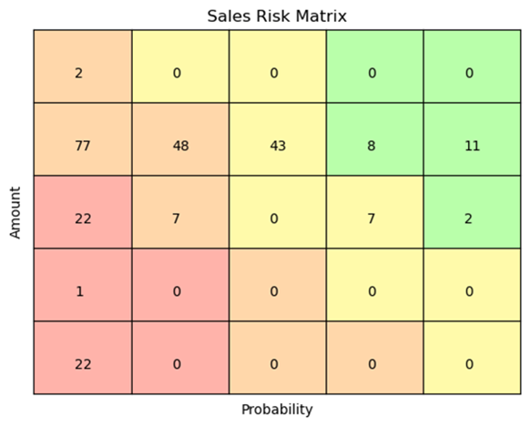
ED&A
Potential Usage of AI
Assess the condition of your open opportunities at a glance with a data infused risk framework. Identify high value opportunities and high probability wins straightaway. Benefit from AI and advanced statistical models that allow you to identify high value and highly likely to be won opportunities based on patterns from historical sales.
Highly likely to be won
Days | Total Amount | Main Country | MC Products | Total Products | Won opps before | Zero valued prods | Opp Name | Opp number
189 | 425170 | US | 5 | 5 | 164 | 0 | Amgen - Amgevita Early Look Study | 2913998
Higher Value Opps
Days | Total Amount | Main Country | MC Products | Total Products | Won opps before | Zero valued prods | Opp Name | Opp number
960 | 1 | US | 1 | 1 | 2 | 0 | bioMerieux - Preferred Medical Affairs | 2873318
Highly likely to be lost
Higher Winning Probability Opps.
Potential to update the condition of your opportunity based on new data, as soon as its available in salesforce. Identify and build the “automated optimal action plan’’ after each stage.

Slide 6
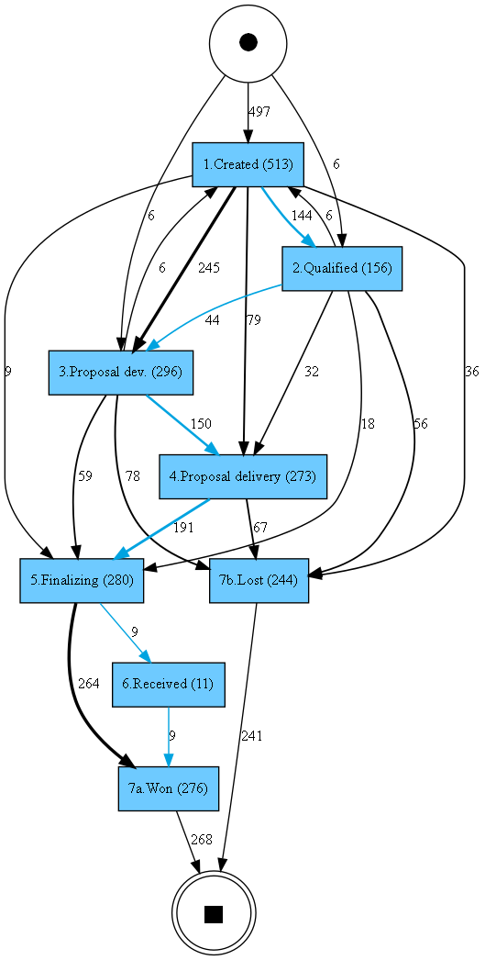
ED&A
Process Mining
In case we have in the systems many data stamps we are able to get a deeper understanding of the process, identifying bottlenecks and inefficiencies. Gain actionable insights into the customer journey, optimizing their experience and reducing time to delivery. The patterns in this data process could be analyzed further.
Many opportunities skip the “2.Qualifying” stage to move directly to “3. Proposal dev.” (245) and “4. Proposal delivery” (79).
92 opportunities have been lost just before or after the qualifying stage, prior developing / delivering proposal from our side to the client.
About a third of the opportunities (59) that reach “3. Proposal dev.” skip the “4.Proposal delivery” stage.
Most opportunities (264) in “5. Finalizing” directly skipped into “7a. Won” (264) and the employees are not using stage 6.
245
1
79
2
36
56
3
59
4
264
4
Displaying arrows only if there are +5 observations

Slide 7
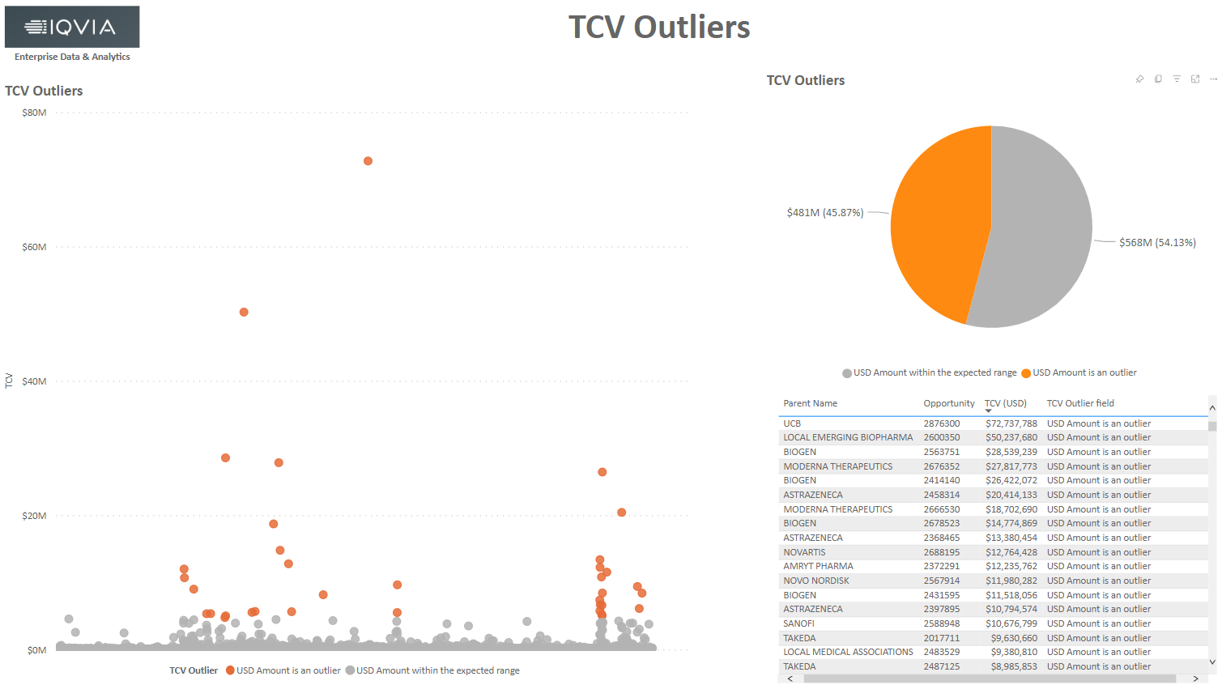
ED&A
Data Quality Checks
In the data analyses process, potential duplicate records, inconsistencies and anomalies deviating from normal patterns are causing concern as they can lead to inaccurate conclusions and faulty decision-making if not identified and addressed through appropriate data cleaning and preprocessing techniques.
Possible duplicates:
Opportunity IDs with fully duplicated data or duplicated with deviations
Not populated fields
Opp_id | Stage | COE
930090 | In-Hand | -
Opp_id | Stage | Primary Loss Reason
1007874 | 7b. Closed Lost | -
Outliers
Opp_id | Average | Upper Limit | TCV Value
2876300 | 359,977.29 | 4,657,351.82 | 72,737,788
Date inconsistencies:
Missing deadlines
Deadline < Start date
Anomalous values
Opp_id | start_date | close_date | deadline
XX0679 | 2022-07-09 09:56:54.750 | 2022-12-19 01:41:34.103
Opp_id | start_date | deadline
LL0255 | 2021-10-31 22:41:35.397 | 2021-05-13 22:00:00
Opp_id | deadline
CC5032 | 5380-04-27 17:00:00

Slide 8
Agenda
Data
ED&A Projects
Overall Project Roadmap
Projects Walkthrough
USBU POD Reporting Automation
MedSci Opportunity Tracker
USCAN
Analytics

Slide 9
ED&A
DATA
2023

Slide 10















ED&A
Data Sources
Data Sources
Data Types
Projects to Date KPI’s
Future Data Sources
Total Contract Value (“TCV”)
Opportunity Pipeline
I/S Details for Actuals and Forecast: Revenue, Expenses, and EBITDA
Global Headcount (MRA)
Global Compensation (not by FTE)
Translations Operational Data
Customer and GL Master Data
Opportunity Win/Loss Rate
Sales/Revenue vs Target %
Opportunity Pipeline by PIC, RBU, GBU, and Stage
I/S Details by RBU/GBU and Cost Center
Headcount and Compensation Reporting
Gross Margins by RBU/GBU
Estimated Timing: TBD

Slide 11
ED&A
Projects
2023

Slide 12

ED&A
Overall Projects Roadmap
Legend
ED&A Projects LTD
Not Started
Ongoing
Completed
Projects | 2022 |  | 2023
 | Nov | Dec | Jan | Feb | March | April | May
USBU POD Reporting
POD Report Automation
CSIH
PSA/ Smartsheet integration
MedSci Opportunity Tracker
Main Dashboard
Quality Check /Analytics & individualized reporting
GSE Monthly Account Dashboard
Sample Dashboard
Integrated Dashboard + QC Report
Parallel Run
USCAN
Manual Slides Dashboard
Slides recreation
P1 metrics
Priority 2 & 3 Metrics
ITS Data Warehouse
Data Lake – Raw Data
Data Warehouse – Curated Data
Dashboard creation
Atlas Internal Project
Timelines TBC
LAUNCH
Timelines TBC
Deep-dive in following slides
Today

Slide 13







ED&A
USBU Proof of Delivery (“POD”) Reporting
Project Status: COMPLETED – Jan 2023
TEAM
DATA SOURCES
BUSINESS CASE
US BU Comm. Ops
Key Sponsor: Joey Mattisson, Director, Sales Operations
The US BU Commercial Operations team was performing a highly manual process in order to compile and share a daily POD Report via Sharepoint, highlighting projects requiring proof of delivery.
After a 2-month engagement with the ED&A team, the report generation and distribution has been fully automated.
SOLUTION
Publish report in SharePoint
Manual work avoidance
Accurate Reporting
Report shared daily and 2X per day + weekend/holidays during MEC period
Daily email to users
BENEFITS
KEY METRICS
35 hours saved per month
$14K* yearly savings
40+ Reports & Summary Emails Sent Monthly
300+ users receiving daily emails
Higher POD delivery frequency and availability
Business to track POD timely and effectively + accelerate revenue recognition
* Calculation per month: Onshore 15h x 67.3€/h + Offshore 20h x 6.7€/h

Slide 14

ED&A
MedSci Opportunity Tracker
Project Status: In Development – Target Feb 2023
TEAM
BUSINESS CASE
US RWES – Medical Scientific
Key Sponsor: Jennifer Christian, VP & GM, MedSci, RW, US
Prior to ED&A´s involvement MedSci team was lacking real-time automated metrics, leadership had low visibility on area performance and PIC´s were only receiving ad-hoc reporting 2X per year.
Key Metrics
After 4 months engagement, results have been:
672 Opportunities
Weekly real time reporting for Leadership
Clear KPIs and metrics
Individualized reporting for ~ 20 unique PICs
(distributed every 2 weeks via email)
$36M Revenue
(Year 2022)
(Year 2022)
DATA SOURCES
BENEFITS
$93M TCV
56% Win Rate
Improve Go To Market Strategy – increase sales win rate & identify new revenue streamlines
Visibility on teams' performance
(Year 2022)
(Year 2022)
Period Covered: 2021, 2022 & 2023

Slide 15



ED&A
MedSci Opportunity Tracker (cont.)
Project Status: In Development – Target Feb 2023
SOLUTION
KPIs available
Data Sources
Data Processing
Data Output
Overview
Volume of Opportunities
Opportunities by:
Status
COE
TCV Value by PIC – Won/Lost/Awarded/Pipeline
Lost Opportunities
PSA / CRM
LT General Overview
Top 15 Clients by Value of Lost Opportunities
Volume of Opportunities:
Lost
Lost after Stage 4
By Primary Loss Reason
1
2
PIC Overview
Parent Overview
MRA
Individualized reporting
Opportunities and TCV Value by Parent
Revenue by Year, Main Delivery Country, Parent Name and Client Name
Parent with highest and lowest TCV
Revenue
+ 40 individual Dashboards sent every month
Revenue by:
PIC
Parent Name
Period – Year, Quarter & Month
1
API connection
PIC Overview
2
Manual data refresh
Dashboard refreshed on a weekly basis
Volume of Won Opportunities and TCV per PIC
Win Rates per PIC

Slide 16
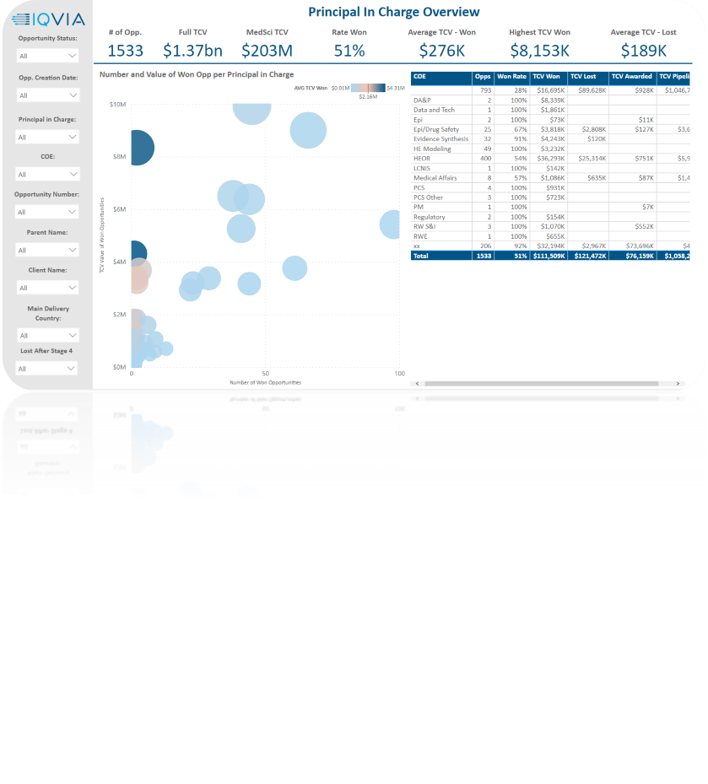
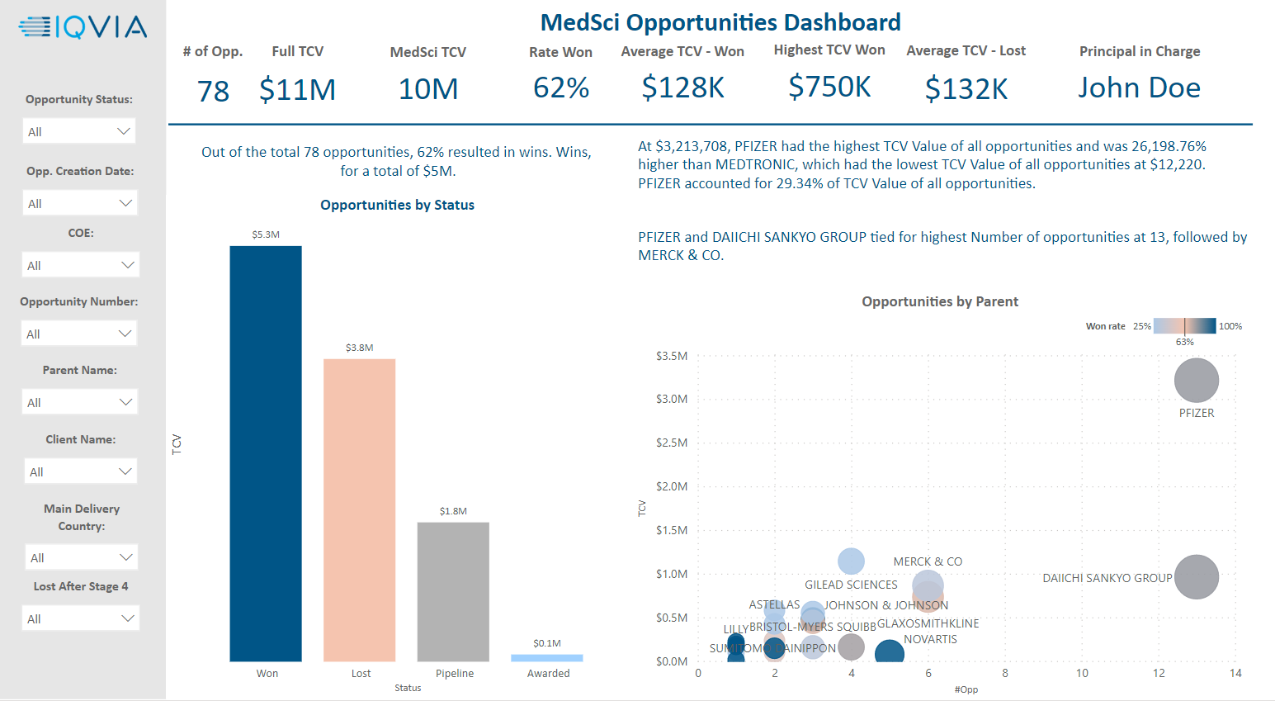
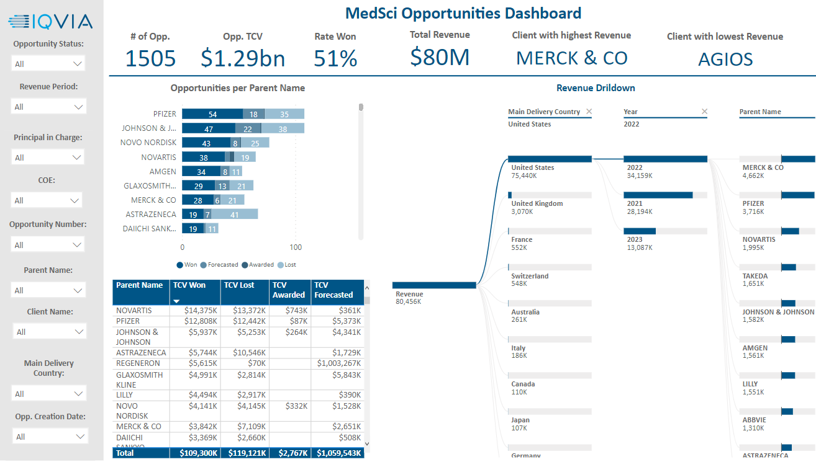
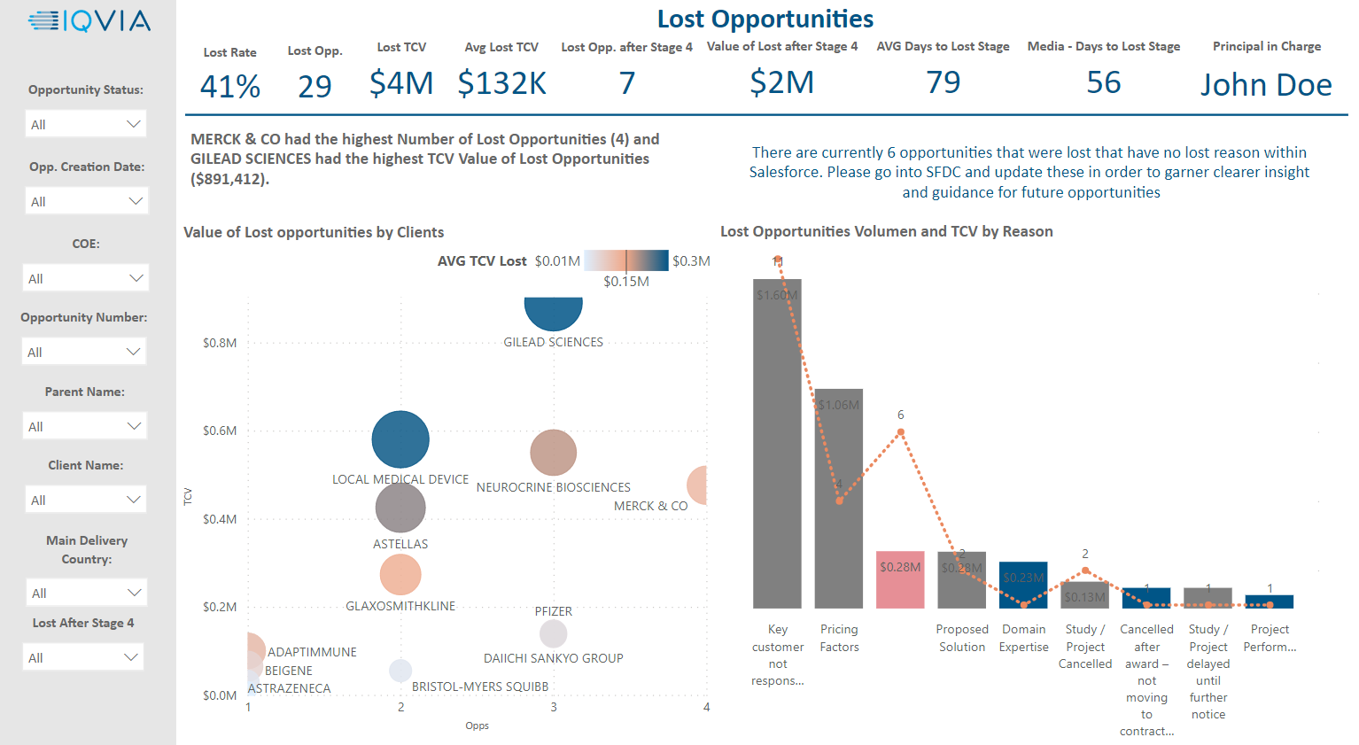
ED&A
MedSci Opportunity Tracker (cont.)
Project Status: In Development – Target Feb 2023
DASHBOARD EXAMPLES
General Overview
PIC Overview
Dashboard focus on Opportunities lost after Stage 4 where proposal has already been made to client
Dashboard enables to filter #Opportunities, TCV and Revenue generated by different elements: Date, PIC, Client, Delivery Country, COE…
Link to Dashboard

Slide 17
ED&A
USCAN Operational Excellence Dashboard
Project Status: In Development
TEAM
BUSINESS CASE
USCAN – Operational Excellence
Key Sponsor: Jody Fisher,
VP, Operational Effectiveness
The US/CAN Op Ex team was manually extracting data to do analysis and drive efficiencies.
ED&A team has been able to produce an automated report that will drive consistent RBU reporting, including newly defined KPIs to support performance tracking.
Key Metrics
$57M Target cost reduction
Manual work reduction
Accurate Reporting
Report & slides shared monthly
2 Countries
(Year 2023)
DATA SOURCES
BENEFITS
Support and identify opportunities as part of Project Boost cost reduction target of $57M in 2023
Time reduction for OE team preparation and analysis process
+$673M Fee EBITDA
+$655M Gross Margin
(Year 2022)
(Year 2022)

Slide 18
ED&A
USCAN Operational Excellence Dashboard
Project Status: In Development
SOLUTION
KPIs available
Data Sources
Data Processing
Data Output
Fee Revenue
EBITDA
Fee Revenue Mix & Growth % by:
Business line
Year, Quarter & Month
Controllable & Non-Controllable
EBITDA Mix & Growth % by:
Business line
Year, Quarter & Month
Controllable & Non-Controllable
Compensation
Marketing Spend
Total Labor Costs,
Total Comp. excluding Temp Labor & Fee revenue per FTE by:
Business line
Year, Quarter & Month
Controllable & Non-Controllable
Marketing spend by:
Business line
Year, Quarter & Month
Controllable & Non-Controllable
Gross Margin
3rd Party Expense
Dashboard delivered monthly
Gross Margin &
Gross Margin vs Revenue by:
Business line
Year, Quarter & Month
Controllable & Non-Controllable
3rd Party Expense &
3rd Party Exp spend to OPEX % by:
Business line
Year, Quarter & Month
Controllable & Non-Controllable

Slide 19
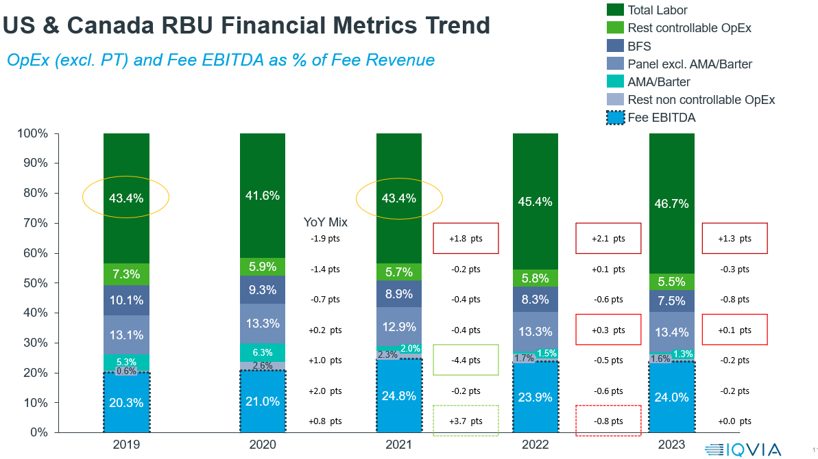
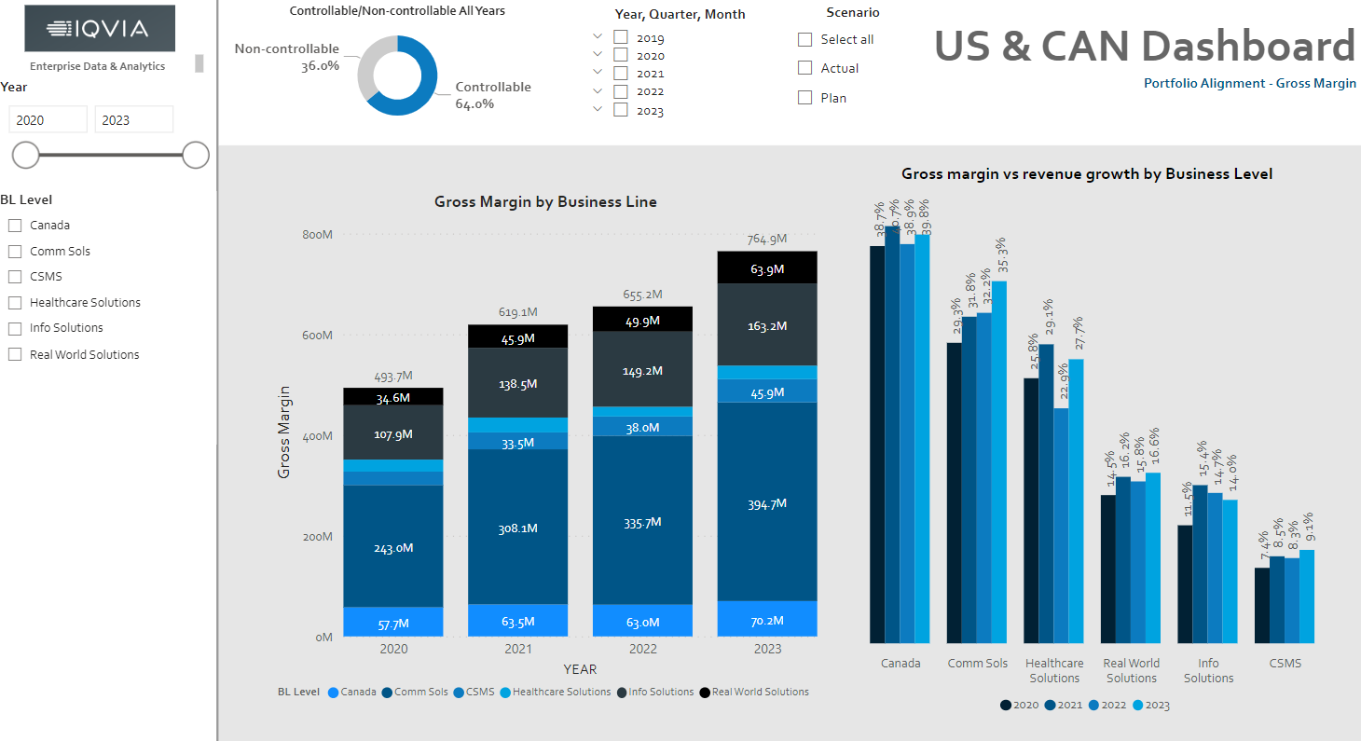
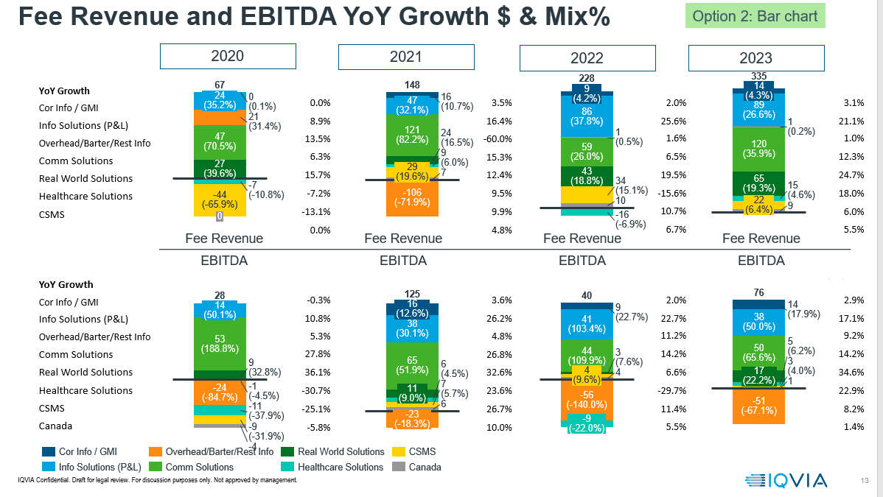
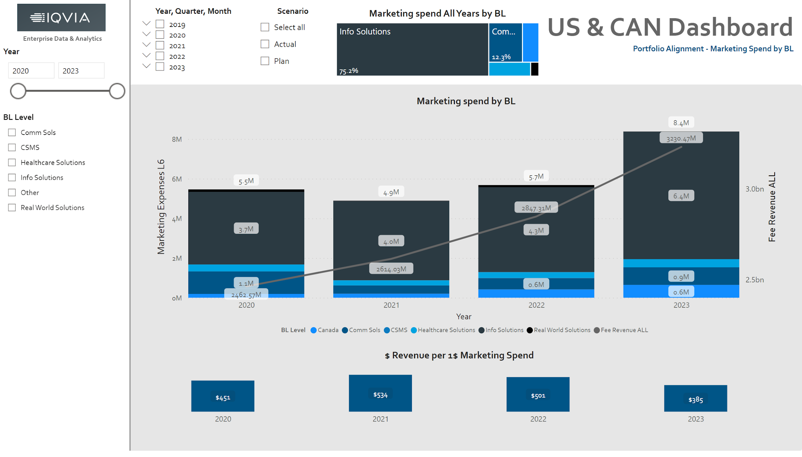
ED&A
USCAN Operational Excellence Dashboard
Project Status: In Development
DASHBOARD EXAMPLES
USCAN - BEFORE
USCAN AFTER
Link to Dashboard

Slide 20
Appendix

Slide 21
ED&A
Enterprise Cloud Data Platform (ECDP)
Timeline: After initial Data Lake setup, data mart sequencing to be validated
2022 | 2023 * | 2024
POC, Planning, Approval
Data Lake Setup
(Foundation)
CRM
PSA
POC:
Marketing ROI
MRDW
AR Reporting
HR
SAP
Data Curation and Data Mart Creation
PeopleSoft
Scope:
Workday
SAP
PeopleSoft
SFDC CRM
SFDC PSA
EBX
MRDW Snowflake Migration
MRDW Integration
* 2023 Plan Pending Approval
MRDW Parallel Test
Eloqua
Coupa
Additional Sources
SN

Slide 22























ED&A
Enterprise Cloud Data Platform (ECDP) - Snowflake
Current Status
DATA SOURCES
Orchestration and Workflow
Devops
DATA
CONSUMPTION
CORE DATA SOURCES
ENTERPRISE CLOUD DATA PLATFORM
BUSINESS INTELLIGENCE
DATA INTEGRATION
RAW DATA
CURATED DATA
ACCESS/ANALYSE
DATA LAKE
TRANSFORMATION SERVICES
DATA MARTS
DATA ACCESS SERVICES
ANALYSE
Change Data
Capture
Finance
Materialised
Views
Data Science
APPLICATIONS
L2 Data
Streams and Tasks
MRDW
Azure Private Link
HR
Distribution Services
Replicate
Zero Copy Clone
Azure Private Link
SnowPark
FUTURE DATA SOURCES
SFDC
AI/ML
Stream
L3 Data
Stored Procedures
Application Program
Interface
APPROVED EXCEPTIONS
Marketing
GOVERNANCE
Extract
Administration
Role Based Access
Audit
Metadata

Slide 23


ED&A
Projects Overview
CSIH
USBU POD Report
GSE Monthly Account Dashboard
MedSci Opportunity Tracker
Area: Comm. Solutions Insights Hub
Status: Complete
Goal: Automation of data extraction from PSA & Smartsheets
Business Case:
Time savings of 60 hours month – cost savings of $23K year
3rd party cost avoidance of $34K (Phase I) and potential $700K in future phases
Go Live: COMPLETED – Feb 2023
Area: USBU Commercial Operations
Status: Complete
Goal: Automate the extraction and data transformation of Proof of Delivery report
Business Case: Time savings of 35 hours month – cost savings of $14K year. Higher POD delivery frequency and availability
Go Live: COMPLETED – Jan 2023
Area: Global Sales Excellence & Insights
Status: Development - Testing
Goal: Automate monthly dashboard process of global financial customers & executive dashboards for IQVIA top 60 accounts
Business Case: Time savings of 120 hours month. Accurate reporting for sales incentives.
Go Live: Estimated Feb 2023
Area: US RWES – Medical Scientific
Status: Development
Goal: Automate the extraction and data transformation of Proof of Delivery report
Business Case: Sales / Go to Market Strategy - increase sales win rate & identify revenue streamlines
Go Live: Estimated Feb 2023
Legend
Cost Savings / Revenue increase
Accurate Reporting, Time Savings

Slide 24
ED&A
Projects Overview
USCAN Business Metrics
ITS Data Warehouse
Atlas Internal Project
LAUNCH
Area: Finance USCAN
Status: Development
Goal: Creation of new report and slides for the OE Analysis for USCAN
Business Case: Identify cost reduction of overall $57M RBU target
Area: Business Operations - Translations
Status: Development
Goal: Build Data Warehouse to integrate different data sources and perform real time analytics for translations team (currently does not exist)
Business Case: Cost avoidance with 3rd party, enable Go to Market Strategy
Area: Business Operations – ED&A (Internal)
Status: Development
Goal: ED&A Global Product that combines data across IQVIA systems to provide real time data & analytics to our partners
Business Case: Cost Savings identification, Upside Opps identification
Area: Commercial Solutions – Offering Dev
Status: Assessment
Goal: Creation of Dashboard to track and accelerate IQVIA growth on Launches
Business Case: Support Business growth (RIH) in 2023 of +44M$ across priority Launches. Reduction of time spent in QC
Legend
Cost Savings / Revenue increase
Accurate Reporting, Time Savings

Slide 25
ED&A
GSE&I Monthly Dashboard
Project Status: In Development – Target Feb 2023
TEAM
BUSINESS CASE
Global Sales Excellence & Insights
Key Sponsor: Michelle Fleming,
VP, Marketing Strategy
Due to lack of single source of the truth regarding Customer financial data, GSE&I team was manually generating monthly Dashboard for IQVIAs top 60 Accounts with the aim to support GAD decision making and feed into incentives process.
Key Metrics
After 4 months engagement, results are:
Manual work reduction
Reduction from 60 Dashboards to single one
Increased efficiency and reduced reporting error and discrepancies
~$13B Sales
60 Top Client Accounts
(Year 2022)
DATA SOURCES
BENEFITS
~ 120 hours saved per month (60h GSE&I team and 60h GAD review)
Reliable data for strategic decisions and incentive process
~$5B Revenue
+ 120 countries
(Year 2022)

Slide 26

ED&A
GSE&I Monthly Dashboard
Project Status: In Development – Target Feb 2023
SOLUTION
KPIs available
Data Sources
Data Processing
Data Output
KPI Overview
Actual Sales vs Target
Revenue vs Target
Sales plan achievement vs target
Business revenue % to plan
Sales pipeline, FY gap to plan
Win Loss
Dashboard containing 60 accounts
Win/Loss by:
Value
# Opportunities
Quality Check Dashboard
Sales & Revenue
SQL Database
Sales/Revenue by Segment, Area and Line
Cumulative Sales / Revenue by Quarter
Past Due
Past Due Dates by Account: 1 – 15 Days, 16 – 30 Days, 31 – 60 Days, 61 – 90 Days, +91 Days
Manual Inputs
Pipeline
Pipeline by:
Segment, Area, Line
Stage
RBU
Dashboard delivered monthly
All metrics can be filtered by Account (60 Top Client Accounts)

Slide 27
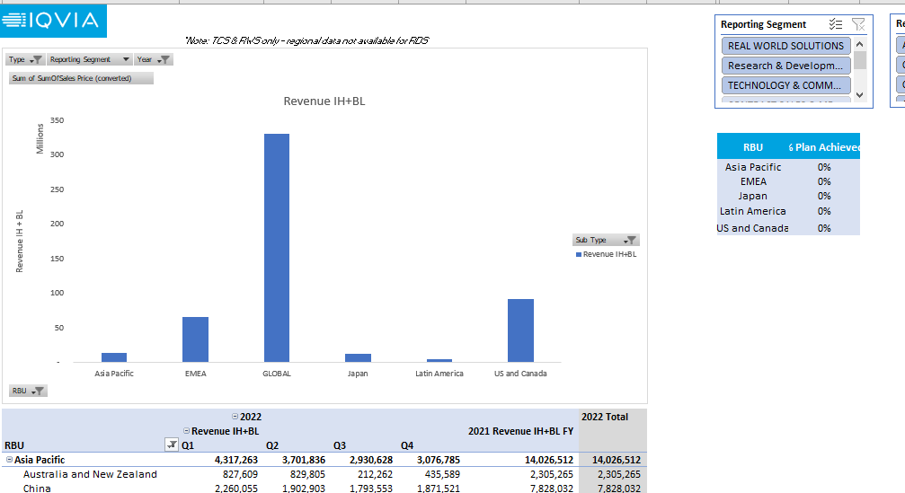
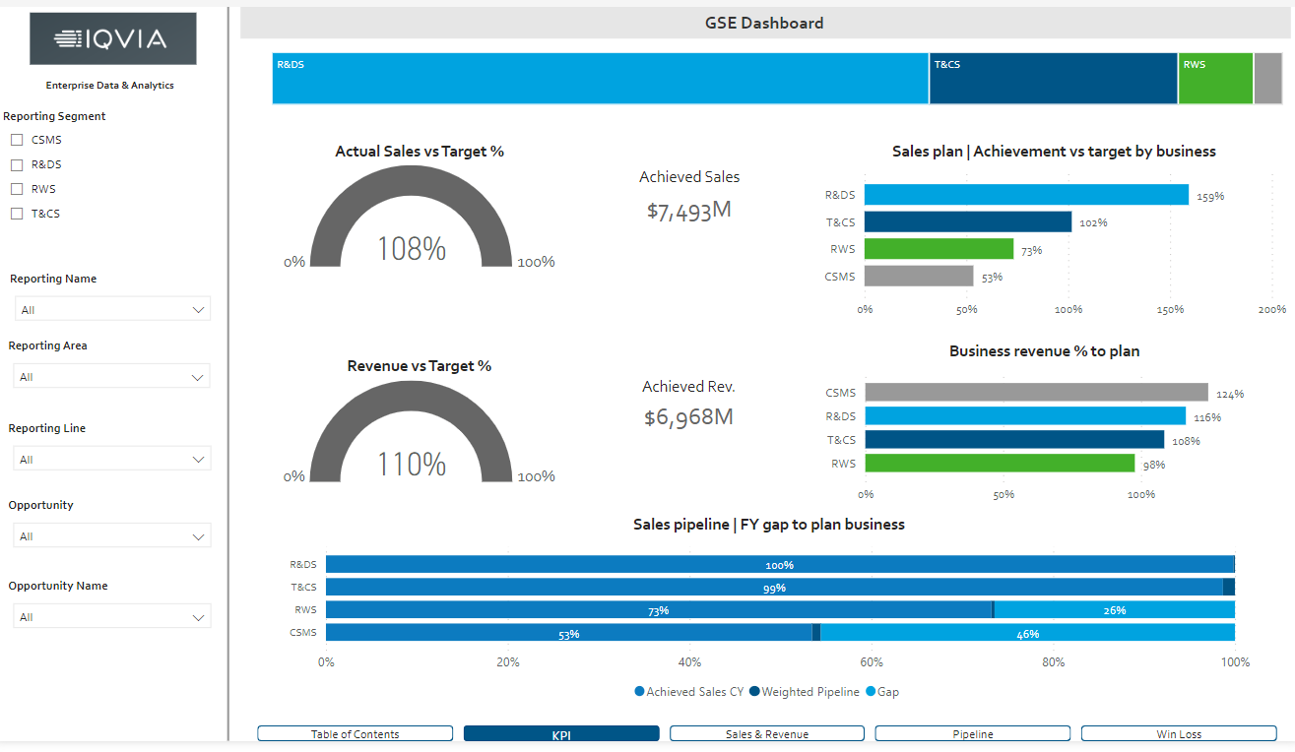
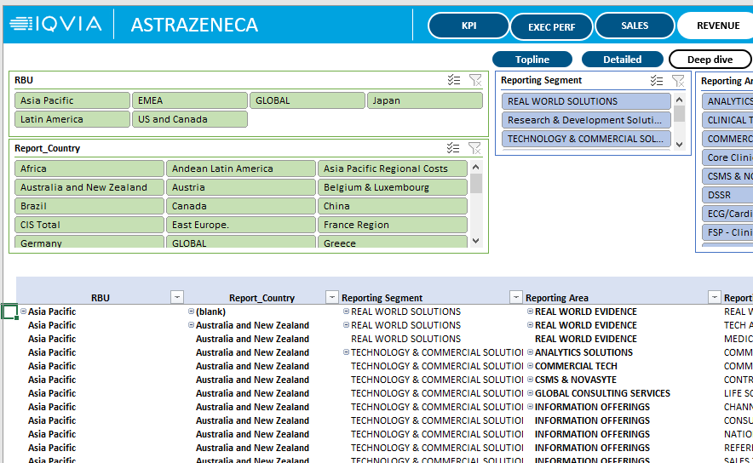
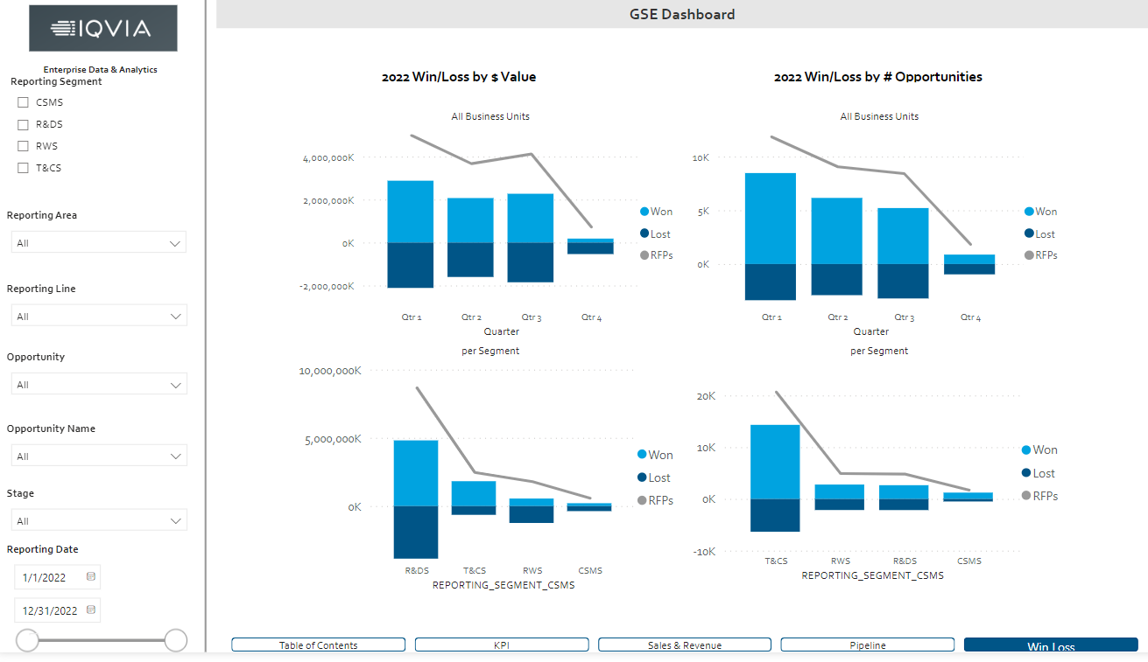
ED&A
GSE&I Monthly Dashboard
Project Status: In Development – Target Feb 2023
DASHBOARD EXAMPLES
GSE - BEFORE
GSE AFTER
60 Excel Dashboards – 1 per each Account
One unique Dashboard that can be filtered by each of the 60 Accounts
Link to Dashboard

Slide 28


ED&A
CSIH Data Access Improvements
Project Status: COMPLETED – Feb 2023
TEAM
DATA SOURCES
BUSINESS CASE
CSIH – Op. Effectiveness
Key Sponsor: Navin Rana,
Sr Director, Operational Effectiveness
The US Commercial Solutions team had a dashboard that required heavy manual effort in order to extract and consolidate data together on a timely basis.
The ED&A team has been able fully automate the extraction and consolidation process, avoiding the need for a 3rd Party to implement a costly design.
SOLUTION
Daily alert email to stakeholders
Manual work avoidance
Report shared daily
CSIH SQL Database
BENEFITS
KEY METRICS
106 hours saved per month
Higher PSA & Smartsheet delivery frequency and availability
4 Reports
refreshed daily
1 Report
refreshed monthly
$40K yearly savings

